Slide 1
V10 Configuration
Configuring Search

Slide 2
Assessment Creation process
Objective
At the end of this session you will be able to :
Describe how Guidewire applications enable users to search for entities
Extend SearchCriteria entities
Modify ClaimCenter search screens
Modify contact search

Slide 3
Searches and Search Criteria

Slide 4
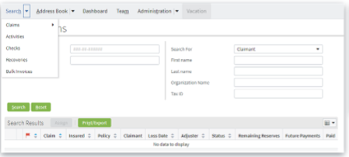
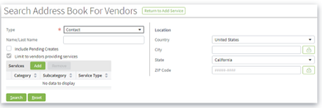
ClaimCenter enables two kinds of search
Search within ClaimCenter
Claims, Activities, Checks, Recoveries, Bulk Invoices, Users, Groups
Vendor / Contact Search
Searches address book application
ContactManager or third-party application
Vendors and other contacts
Related to service requests
Notes:
ClaimCenter provides search capabilities for many of the most important entities in the application, in addition, with integration to an address book ( such as Guidewire ContactManager) you can search for preferred service providers. The mechanism behind this search capability is a bit complex, and that’s what we are going to study in this lesson.

Slide 5
Searching for entities

Slide 6
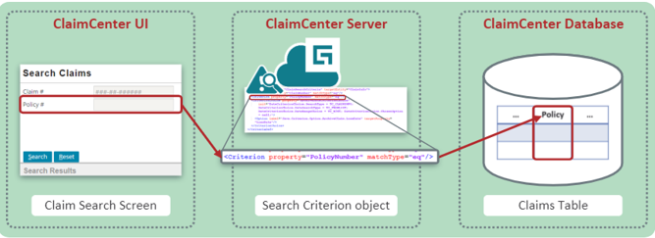
Search within ClaimCenter
ClaimCenter server creates a SearchCriteria object from choices in the UI
Uses the SearchCriteria object to query the database
Notes:
A search within ClaimCenter has three main steps :
First, the user enters search criteria on the search screen. Every field on the search screen is a criterion that can be searched on.
Then, ClaimCenter combines these criteria into a SearchCriteria object. This is a virtual object that is not stored in the database. Rather it is used programmatically to create a SQL search that is then submitted to the ClaimCenter database.
The database is searched on those criteria and only those criteria, which the user entered and results are returned to the ClaimCenter server which displays them in the search results list.

Slide 7
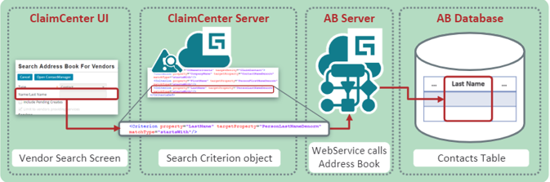
Vendor or contact search
ClaimCenter server forms a SearchCriteria object from choices in the UI
Extracts search terms from SearchCriteria object
Passes search terms to address book application via Web Services
Notes:
A search for a vendor has a similar structure with an additional step.
After creating the SearchCriteria object, ClaimCenter uses Web Services to pass the criteria to the Address Book application such as ContactManager which then forms a SQL query of its database. The Address Book returns the results to ClaimCenter via Web Services, and ClaimCenter once again formats the results for display.

Slide 8
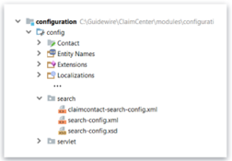
Search Criteria Object
Virtual, non-persistent entity with no underlying database table
Virtual fields match actual fields in target database
Implemented by file
Notes:
The ClaimCenter search criteria object is a virtual object, meaning that there is no underlying table and it cannot be stored in the ClaimCenter database. It is created on the fly for each search – users cannot save “favorite” searches.
Note : In ContactManager, the search criteria is a “real” entity – in fact, one of the several entities such as ABContactSearchCriteria

Slide 9
Configuring search criteria

Slide 10
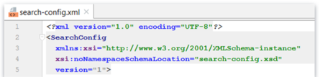
search-config.xml
Defines all searches that can be performed in CliamCenter
Consists of one SearchConfig element and numerous sub-elements
IMPORTANT : DO NOT CREATE ADDITIONAL SearchConig TAGS
This is Not supported by Guidewire
Notes:
Search criteria are defined in an XML file called search-config.xml
All search criteria are defined as sub-elements of a single SearchConfig element.
There can only be one SearchConfig element in a given ClaimCenter implementation. Creating an additional SearchConfig element is not supported by Guidewire and will result in unexpected ( and probably unwanted) application behavior.
The search-config.xml file is found …/configuration/config/search/

Slide 11
search-config.xml elements
SearchConfig: Defines the search criteria available in the application
CriteriaDef: Specifies the mapping from one search criteria entity to the target entity on which to search
Criterion : Specifies matching between a column (field) on the search criteria entity and the target entity
Use only to match values in a single column of the same type in the target entity
CriterionChoice: Defines specialized properties in the search criteria that can match against a number of target fields
Option : Describes a single choice within a CriterionChoice definition
ArrayCriterion: Specifies that the search query uses a simple join against an array entity.
Notes:
As just stated, one SearchConfig element defines the full range of search criteria for the entire application.

Slide 12


CriteriaDef sub-element
Defines a mapping between a key data entity and a search criteria entity
Basic syntax
Sub-elements can include Criterion, CriterionChoice and ArrayCriterion
WARNING: Guidewire does not support creation of new CriteriaDef elements
WARNING: Guidewire strongly recommends not removing existing CriteriaDef elements
Notes:
CriteriaDef is a sub-element of SearchCoonfig. It has two properties: a name and a target entity. It defines the ability to search for instances of the target entity.
CriteriaDef has several sub-elements which will be discussed in turn.
The important thing to remember is that Guidewire provides a fixed set of CriteriaDefs. Adding CriteriaDefs is not supported and may result in unwanted application behavior. Removing a CriteriaDef is possible, but not recommended. But you can edit, add, and delete the Criterion, CriterionChoice and ArrayCriterion subelements.

Slide 13
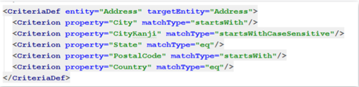
matchTypeTag
matchType determines how the target property is matched to the criteria property
Seven main choices:
contains
eq
ge
gt
le
lt
startsWith
Notes:
The matchType tag of the Criterion sub-elements is a required tag that determines how to search on a given property of the target entity
Four matchTypes are usable only for numeric values: ge means greater than or equal to; gt – greater than, le – less than or equal to, and it less than
Two matchTypes – contains and startsWith – are usable only for string types. Contains is the most “expensive” in terms of search time and should be avoided wherever possible.
eq ( meaning equals) is usable for all property types and is the only meaningful for typelist search

Slide 14

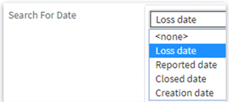
CriterionChoice sub-element
Allows a single criterion to match against one of several columns in the target, as chosen by the user.
For example, the Date CriterionChoice element on the Advanced Claim Search screen allows users to search for one date: the Loss date, the Reported date, the Closed date, or Creation date
Basic Syntax:
May have one or more option elements
Notes:
The main purpose of the CriterionChoice sub-element is to allow multiple criteria to be searched in the same screen real estate.
One possible disadvantages is that you can only search by one of these criteria at a time. So if we had both the Loss date and Closed date. We could only search on one of them.

Slide 15
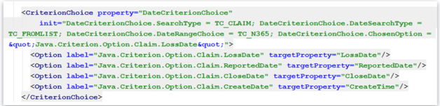

CriterionChoice sub-element example : DateCriterionChoice
The label must refer to display key
The targetProperty attribute is required when adding new Options
Including all option subelements on new CriterionChoice subelements
Notes:
The Option sub-elements determine what can be searched for:
The label tags are display keys that determine what is actually displayed in the chooser.
The targetProperty tags determine what field of the search entity is actually searched on.

Slide 16
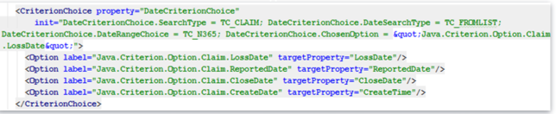
Optional init attribute of CriterionChoice
In this example, the init attribute specifies how to restrict the date field.
The user can restrict the date range either through a typelist of preset ranges ( such as next 30 days) or through a specific start and end date
The init attribute sets the value
Notes:
The init tag of the CriterionChoice sub-element determines how the application displays the criteria. In the example shown, it determines:
The SearchType tag TC_CLAIM determines what object is searched from the SearchObjectType typelist.
The DateSearchType typelist TC_FROMLIST determines that the “Since” option is selected from the DataSearchType typelist.
The DateRangeChoice tag TC_N365 determines that “Last 365 days” is selected from the DateRangeChoiceType typelist
The ChosenOption tag Java Criterion Option Loss Date determines that the Loss Date option is selected in the Search For window

Slide 17


ArrayCriterion
Instructs ClaimCenter to add a simple join against an array entity to the search query
For example, the Claim entity has an array of officials
So you could add an ArrayCriterion that searched for officials of a given name or type
Basic Syntax
All attributes are required
Supports equality matching only
Therefore, you cannot specify a matchType attribute on ArrayCriteria
Notes:
The ArrayCriterion sub-elements enables search on an array entity of the main entity. In the example shown, Claim’s array of Officials is used to search on the official type. So for example, you might search for a claim that had at least one Police officer associated with it.
The property tag is the name you assign to the ArrayCriterion
The targetProperty is the name of the array on the search object – in this case, the officials array on Claim.
The arrayMemberProperty is the name of the property to search for, not on the search object. But on the entity referenced by the array – in this case, the Official entity.
There are no optional tags, and you cannot specify any matchType; only equality supported.

Slide 18
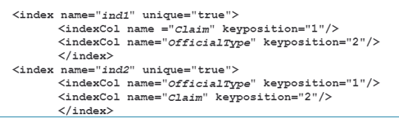
ArrayCriterion (Continued)
Is not used in the base application
Most commonly used for joins to custom entities
The arrayMemberProperty cannot allow duplicate values
Otherwise the same target instance might appear multiple times in the search results
Two indexes must be present on the array table
The first must be on the foreign key back to the main table and your chosen arrayMemberProperty
The second must be on the same two properties but in the reverse order (arrayMemberProperty first)
Notes:
Note that there are no ArrayCriterion sub-elements in the base configuration of ClaimCenter 10. It is mostly used when an insurer creates a custom entity and wants to search based on it.
The arrayMemberProperty must be unique for each instance of the main search object – in the example, there should be no more than one official of any given type ( Since there in fact can be more than one official of any given type, this is actually a bad example)
Finally, you must create two indexes on the array table. The first is based on the array object’s foreign key back to the main search object and the arrayMemberProperty which is being searched. The second is based on the same properties in reverse order.

Slide 19
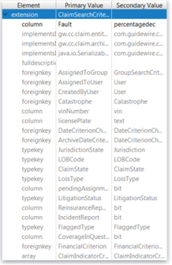
SearchCriteria entities
Every CriteriaDef sub-element references by its name a SearchCriteria entity
These entities are created by Guidewire
Do not create a new one
When adding a new column to search for, you must add the column to the SearchCriteria
To search for a simple column on the target entity, create a column
To search for a column which is a foreign key on the target entity, creates a foreign key
To search for a column which is a typekey on the target entity, create a typekey
To search for an array on the target entity, create an array
Notes:
Just as you should not add any CriteriaDef sub-elements to search-config.xml. You should not add any SearchCriteria entities to ClaimCenter. These entities exist in a 1:1 relationship with the CriteriaDef sub-elements and determine what can be searched what can be searched for in the main search entity.
You can, however, add a new column to search for and infact, you must do so if you add a new column to search-config.xml

Slide 20
Review Question
What is the underlying table for a search criteria entity?
There is none; it is virtual, non-persistent entity

Slide 21
Modifying search screens

Slide 22
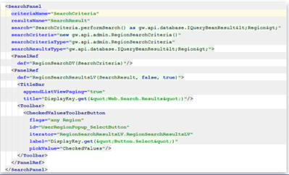
Search using a search panel
Requires many complex properties
Recommended you use existing search panels ( and pages )
If you must create a new search panel/page consult Guidewire Services
Notes:
Searching in ClaimCenter requires the use of a specific UI element called a SearchPanel. The SearchPanel typically includes a search detail view and a results list view
Note that the creation of a search panel is quite complex and well beyond the limits this course. If you need to create a new search panel, you should consult Guidewire Services

Slide 23
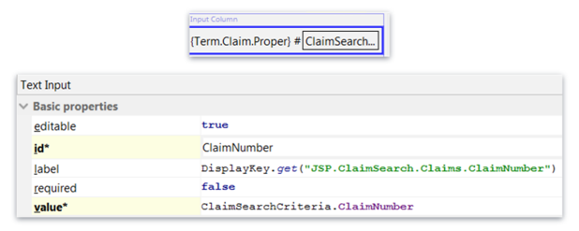
Search Fields
Appear in input sets in search panels
Value for a search field must be property of the appropriate SearchCriteria entity
Notes:
The detail view used for search has a number of input widgets, which refer to the search fields in the SearchCriteria entity referenced by the SearchPanel. You can add fields to the detail view.
Remember that the value properties of these widgets do not reference the search criteria entity. Thus, if you are searching for a claim, you must reference the ClaimSearchCriteria in the widget’s value property.
This means, in turn that if you are searching for a new property. You must make sure that it exists on the relevant search criteria entity.

Slide 24
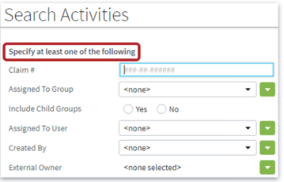
Required search fields
Required search fields ( or groups of fields) are set up by Guidewire
You cannot add required search fields
Attempting to do so is not supported by Guidewire
You should not remove require fields
May have unexpected results
Notes:
The coding to create the required search fields section of the detail view is very complex,. Adding new sections or adding and removing widgets from the existing DVs is not supported.

Slide 25
Finally …
Regenerate the SOAP and Java APIs
Open a command window
Navigate …/ClaimCenter
Run the following command:
gwb genJavaApi
If you have added any new fields to entities ( other than the virtual SearchCriteria)
gwb genDataDict
Restart the ClaimCenter server
Test your changes
Notes:
SOAP is an acronym for Simple Object Access Protocol, an XML standard for web services.
When you have finished configuring search, you must regenerate the API’s. Failure to do so means that the new search terms will appear in the UI but will not be available to the search engine and may result in the server failing to start.

Slide 26
Review Question
What sub-elements can a CriteriaDef element have?
Criterion
CriterionChoice
ArrayCriterion

Slide 27
Review Question
What is special about the input widgets on a search page?
They represent properties, not of the target entity, but of its related Search Criteria entity

Slide 28
Configuring contact search
To add a field to contact search you must configure both ClaimCenter and the address book application
Steps ( with ContactManger)
In ContactManager, add a field as already shown
Add new search capability in ContactManager
Restart ContactManager
Refresh the web services in ClaimCenter
Add ContactManager search capability in ClaimCenter
ContactSearchCriteria.etx
ContactSearchMapper.gs
ContactSearchResultMapper.gs
Test your changes
Notes:
Details of adding a field to contact search are beyond the scope of this lesson. But it is worth being aware that matching configuration must be made in both ClaimCenter and ContactManager ( if that is the address book application used. If not, the services of an integration specialist will be required)
When you have completed the configurations in ContactManager, you must refresh the web services in ClaimCenter to pick up the changed fields in ContactManager. Then you must add the capability for that search to three files in ClaimCenter.

Slide 29
To add new search capability in ContactManager
Extend the ABContactSearchCriteria entity
In search-config.xml, map ABContactSearchCriteria extensions to the ABContact entity
Modify the contact search criteria detail view so that new search criteria can be specified
Optionally modify the contact search results list view to display information about your specified field.
Regenerate the Java and SOAP APIs
Restart the ContactManager server

Slide 30
Review Question
After adding a new search criterion to an existing search page, what must be done?
Regenerate the SOAP and Java APIs
Redeploy and restart the ClaimCenter server

Slide 31
Thank you

